Slide 1

Predicting Football Player Goal Scoring Using AI
Sotia Koukou & Victoras Panayiotides
Professors: Pavlos Protopapas, Ignacio Becker
Mentors: Anshika Gupta, Nawang Thinley Bhutia

Slide 2
Problem Statement:
Predicting the number of goals a player, from the premier league, will score in an upcoming match
Importance of this prediction:
Predicting the number of goals a player is going to score in an upcoming match is a useful insight for the scouting department of the team.
Knowing the goals that will be scored in an upcoming match by a player will help setting up the starting XI and prepare the tactics of the match.
It can help manage the team's attacking players and help the scouting team make decisions on potential transfers.
It will assist fans to bet on players scoring in upcoming matches
Notes:
2nd bullet point: Also,
3rd bullet point: Moreover,
4th bullet point: Lastly,

Slide 3
Data Source:
Data from:
(https://www.kaggle.com/datasets/davidcariboo/player-scores/data)
(https://fbref.com/en/comps/9/keepers/Premier-League-Stats)
Key Features Used:
Position
Minutes Played
Goals Scored
Penalty Shoots Scored
Total shoots
Total shoots on Target
Expected Goals (xG)
Goalkeeper Saves
Penalty Kick Saves
Defense blocks
Notes:
***Data Frame 2 link

Slide 4
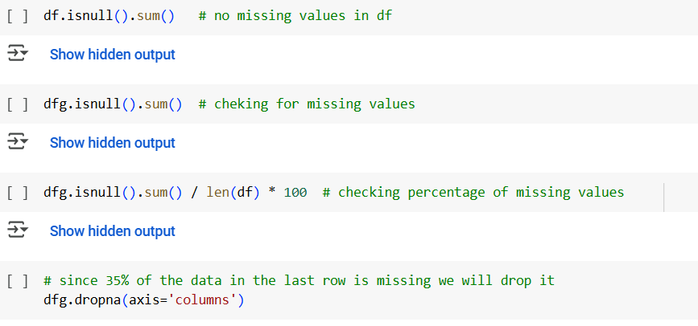
Removing Missing Values
We checked for missing values and removed them using the pandas attributes isnull(), and drop()
Notes:
Pics

Slide 5
Data Visualization
We used histograms to visualise our data:
Notes:
Pics

Slide 6
Data Visualization
We used histograms to visualise our data:
Notes:
Pics

Slide 7
Data Visualization
We used histograms to visualise our data:
Notes:
Pics

Slide 8
Data Visualization
We used histograms to visualise our data:
Notes:
Pics

Slide 9
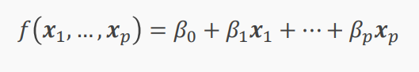
Multi-Linear Regression
We will use multi-linear regression to predict our output making the assumption that there is a linear relationship between the predictor variables and the goals scored
Model Training
We will split our data into Training and Testing
We will use Scikit-learn’s Regression model to output our results
Notes:
Pics

Slide 10
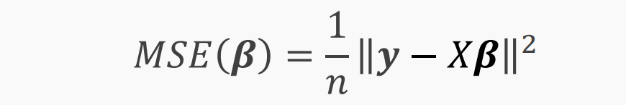
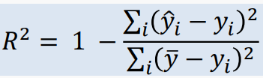

Model Evaluation
Matrices that we will use to evaluate our model include:
Mean Squared Error (MSE)
$R^{2}$ Score
What we changed
From our original strategy we changed some of the predictor variables that were hard to find data about, while also removing columns that had too many missing values

Slide 11
Thank you
for
your Attention

